Slide 1
IBM-AWS GenAI Techathon
2024
Name of the POC: Personalized Assistant with GEN AI
Authors:Satya Mullapudi, Bharathi Lella, Sanjeev Kumar, Durga Prasad,Suhasini Arava

Slide 2
About The Gen AI POC
Prudential Retirement Services
Participants can seek assistance from AI for inquiries regarding contribution status, loan eligibility criteria, fund performance in the market, average rate of returns, transaction history, and information about open/closed trading windows for restricted funds or stocks. With AI guidance, participants can navigate these queries without the need to log a ticket, enhancing efficiency and user experience.
Plan sponsors can utilize AI to monitor their plan health and track payroll changes/fund processing status over time. They can easily pull plan/participant level reports with a single query, streamlining the process and facilitating informed decision-making.

Slide 3
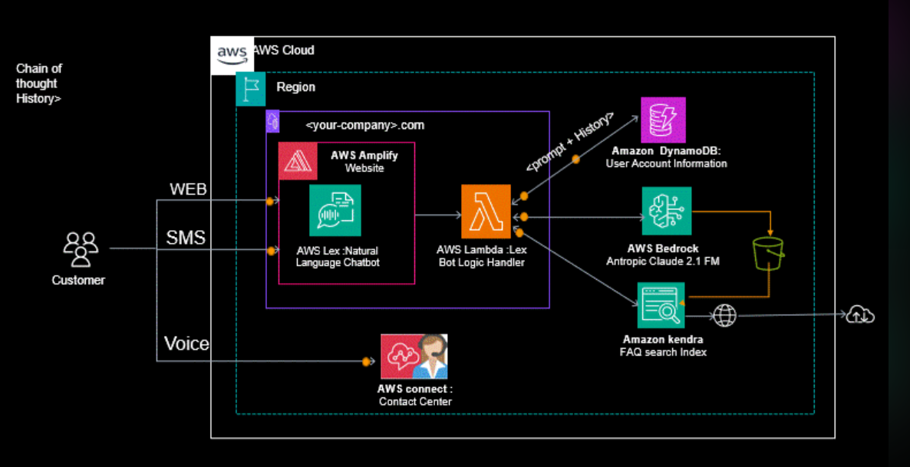
Architectural Diagram
Amazon S3

Slide 4
AWS Services Used
Name of the AWS Service | Purpose
Amazon Lex | Amazon Lex is a service for building conversational interfaces into any application using voice and text. It provides the advanced deep learning functionalities of automatic speech recognition (ASR) for converting speech to text, and natural language understanding (NLU) to recognize the intent of the text, to enable you to build applications with highly engaging user experiences and lifelike conversational interactions.
AWS Lambda | AWS Lambda is a serverless computing service that lets you run code without provisioning or managing servers. You upload your code and Lambda takes care of everything required to run and scale your code with high availability. You can set up your code to automatically trigger from other AWS services or call it directly from any web or mobile app.
Amazon Bedrock | There is no widely known AWS service called "Amazon Bedrock" as of my last update in January 2022. It's possible that this service was introduced after that time, or it could be a project or product developed internally within Amazon.
Amazon DynamoDB | Amazon DynamoDB is a fully managed NoSQL database service that provides fast and predictable performance with seamless scalability. It is designed to scale horizontally and can handle massive amounts of data with low latency and high throughput. DynamoDB is a popular choice for applications that require single-digit millisecond latency for reading and writing data.
Amazon S3 | Amazon S3 is a scalable, durable, and secure object storage service by AWS, allowing easy storage, retrieval, and management of any amount of data with low-latency access and seamless integration with other AWS services.

Slide 5
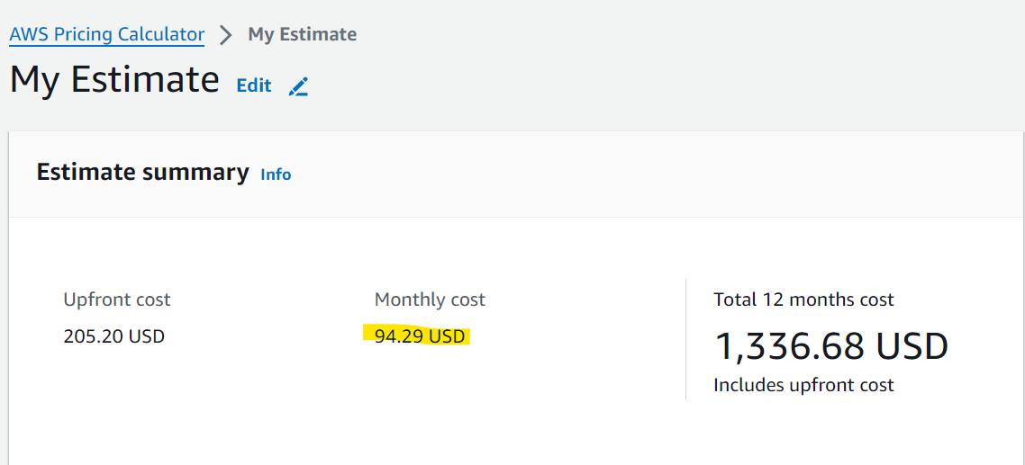
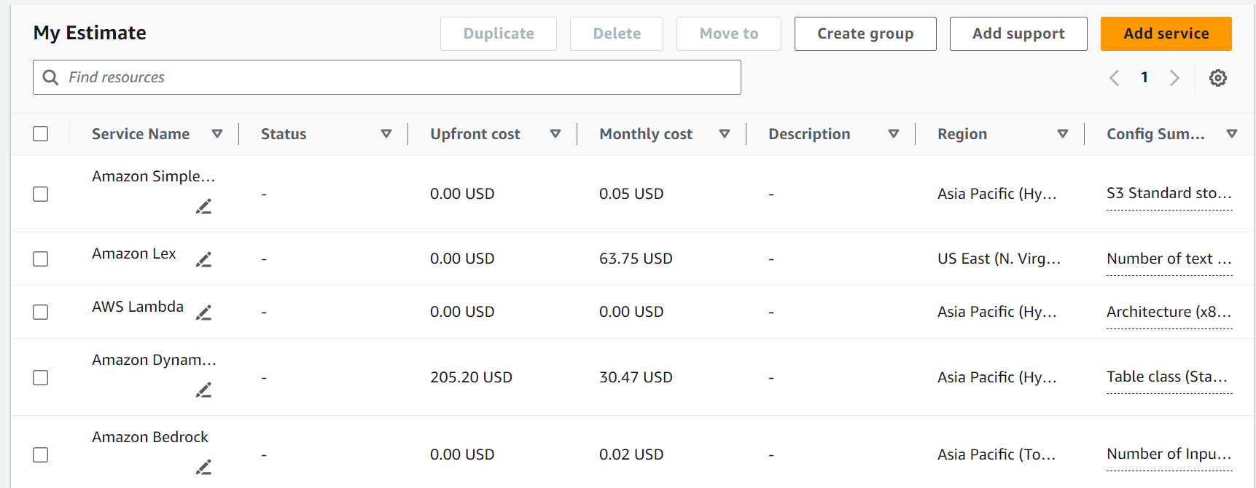
Cost of POC
My Estimate - AWS Pricing Calculator

Slide 6
Impact
How the POC impacts IBM/Customer And Benefits across other customers as follows.
Enhanced Customer Experience:
By leveraging technologies such as artificial intelligence (AI), natural language processing (NLP), and machine learning (ML), businesses can provide personalized and responsive customer experiences.
AI-powered chatbots and virtual assistants can understand customer queries, provide relevant information, and offer assistance in real-time, leading to improved customer satisfaction.
These solutions can also anticipate customer needs based on historical data and interactions, allowing businesses to offer proactive support and recommendations.
Efficiency and Scalability:
Automation and AI-driven solutions can streamline business processes, reducing manual effort and increasing operational efficiency.
Scalable cloud infrastructure, such as AWS, allows businesses to adapt to changing demands quickly and cost-effectively.
With automated processes and scalable resources, businesses can handle increased workloads during peak periods without compromising performance or customer service quality.
Cost Saving:
Cloud-based solutions offer a pay-as-you-go pricing model, allowing businesses to avoid large upfront investments in infrastructure and software.
By automating repetitive tasks and optimizing resource usage, businesses can reduce labor costs and improve overall cost efficiency.
Additionally, cloud providers like AWS offer cost management tools and services that help businesses monitor, analyze, and optimize their spending.
24/7 Availability:
AI-powered chatbots and virtual assistants can provide round-the-clock support to customers, ensuring that assistance is available whenever it's needed.
With cloud-based solutions, businesses can achieve high availability and reliability through features like auto-scaling, redundancy, and failover mechanisms.
Automated processes and self-service options empower customers to find answers and resolve issues independently, even outside of traditional business hours.

